Slide 1

Applied Quantitative Logistics
School of Data Analysis and Artificial Intelligence
Faculty of Computer Science
Multi-Depot
Green Vehicle Routing
Problem
Elie WANKO
Moscow, May 2020

Slide 2

Multi-Depot Green Vehicle Routing Problem
Content
Introduction
Problem Description
Methodology
Scenario/Example
Further Research

Slide 3
Multi-Depot Green Vehicle Routing Problem
INTRODUCTION
Definition
Alternative Fuel-powered Vehicles (AFVs)/ Green Vehicles (GVs) and Conventional Vehicles (CVs).
Low fuel tank capacity and the scarce availability of Alternative Fuel Stations (AFSs).
Partition Based algoritm proposed by Nagy and Salhi (2005)
Use Case
Distributors want to gradually replace their conventionally powered vehicles with Alternative Fuel-powered vehicles (AFVs). How do you maximize the usage of AFVs while satisfying all customers at the end of the day?
Notes:
A standard MDGVRP can be described as finding routes with the least distance from more than one depot to a set of customers. Each customer is associated with a fixed allocated demand to be delivered. Each customer is visited by the vehicle fleet only once, and the demand of the customer is satisfied after each visit. A vehicle starts from a depot, serves customers one-by-one, and, finally, returns to its originally assigned depot. The objective of the problem is to minimize the total carbon emissions of all operating vehicles.

Slide 4
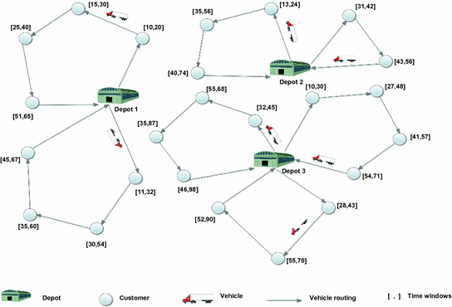
Multi-Depot Green Vehicle Routing Problem
MDGVRP Schema

Slide 5
Multi-Depot Green Vehicle Routing Problem
INTRODUCTION
Related Research
Zhang, S., Gajpal, Y. & Appadoo, S.S. A meta-heuristic for capacitated green vehicle routing problem. Sustainability, (May 2020). [CrossRef]
Salhi, S., Imran, A. & Wassan, S.S. The multi-depot vehicle routing problem with heterogeneous vehicle fleet: Formulation and a variable neighborhood search implementation. Computers & Operations Research, (May 2013). [CrossRef]

Slide 6

Multi-Depot Green Vehicle Routing Problem
PROBLEM DESCRIPTION
$$D = set of depots, with D=\{1,2,…,d\}$$
$$d = the number of depots$$
$$N = set of clients, with N=\left\{1,2,…,n\right\}$$
$$n = the number of clients$$
$$V = set of vertices \left(or nodes\right), with V=\left\{0\right\}∪N, where O is the depot$$
$$A = set of arcs, with A=\{(i,j)∈V^{2}:i≠j\}$$
$$c_{ij} = cost of travel over arc (i,j)∈A$$
$$Q = the vehicle capacity$$
$$q_{i} = the amount that must be delivered to customer i∈N$$
$$GVs = set of Green Vehicles, with GVs=\{1,2,…,g\}$$
$$CVs = set of Conventional Vehicles, with CVs=\{1,2,…,c\}$$
Notes:
Main parameters here are D = set of depots and d = the number of depots

Slide 7
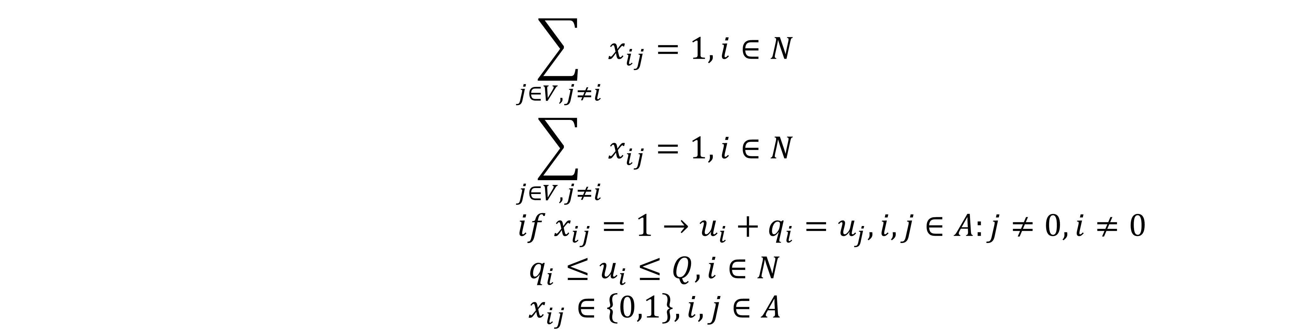
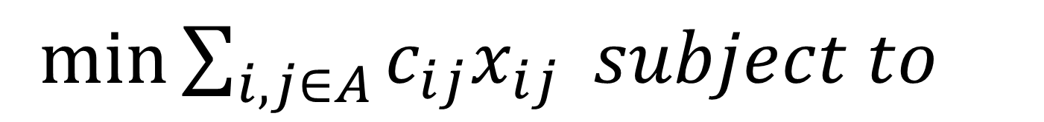
Multi-Depot Green Vehicle Routing Problem
PROBLEM DESCRIPTION
Once we have partitioned, we are remained with a conventional TSP problem.
$$\sum_{j∈V,j≠i}{x_{ij}=1,i∈N}$$
$$\sum_{j∈V,j≠i}{x_{ij}=1,i∈N}$$
$$if x_{ij}=1→u_{i}+q_{i}=u_{j}, i,j∈A:j≠0,i≠0$$
$$q_{i}≤u_{i}≤Q, i∈N$$
$$x_{ij}∈\left\{0,1\right\}, i,j∈A$$
${\min{\sum_{i,j∈A}{c_{ij}x_{ij}} subject to}}$
Notes:
Once we have partitioned, we are remained with a conventional TSP problem.

Slide 8
Multi-Depot Green Vehicle Routing Problem
METHODOLOGY
Step 1: Assign all customers to their nearest depot.
Step 2: Generate a GVRP route for each depot and associated customers as follows.
Step 2.1: Generate GVRP routes based on nearest neighbour criteria (NNC).
Step 2.2: Generate TSP routes from the GVRP routes for each depot.

Slide 9
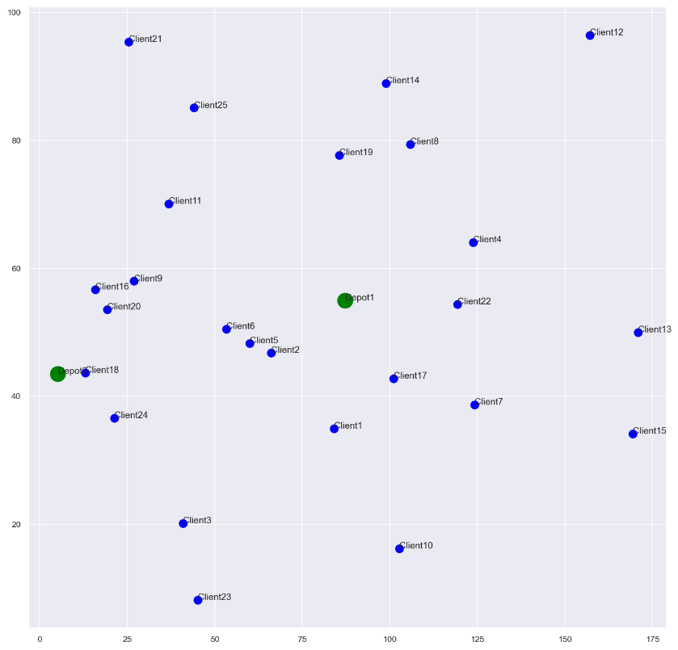
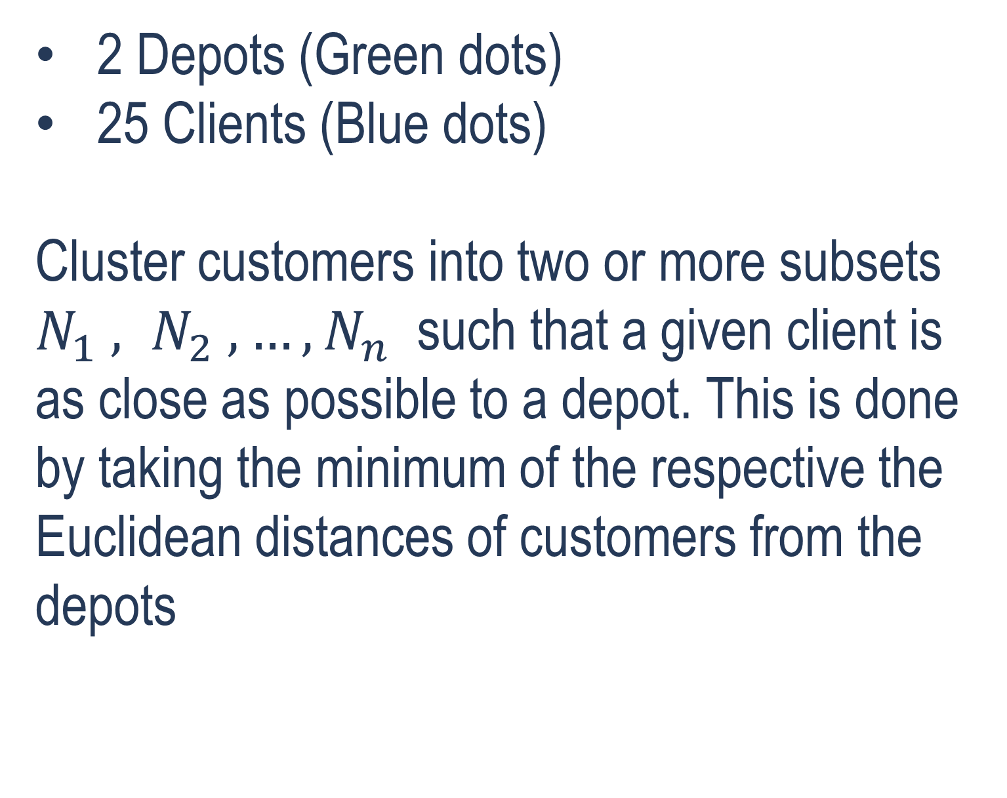
Multi-Depot Green Vehicle Routing Problem
scenario
2 Depots (Green dots)
25 Clients (Blue dots)
Cluster customers into two or more subsets $N_{1} , N_{2} , …, N_{n}$ such that a given client is as close as possible to a depot. This is done by taking the minimum of the respective the Euclidean distances of customers from the depots
Random Schema
Notes:
. The task here is to decide whether for given set 𝑁 of customers, it can be partitioned into two or more subsets $N_{1} , N_{2} , …, N_{n}$ such that a given client is as close as possible to a depot. This is done by taking the minimum of the respective the Euclidean distances of customers from the depots

Slide 10
After running our PBA algorithm, we were able to assign every client to a depot.
Depot ID 0 delivers to 16 clients [0, 1, 3, 4, 5, 6, 7, 9, 11, 12, 13, 14, 16, 18, 21, 24]
Depot ID 1 delivers to 9 clients [2, 8, 10, 15, 17, 19, 20, 22, 23]
with the following relative distances
Depot 1 | Number of Clients - 16
{(0, 0): 20.226549139038344, (0, 1): 22.662684199306916, (0, 3): 37.761750657494936,
(0, 4): 28.069416026405914, (0, 5): 34.12394937776985, (0, 6): 40.44746111176781,
(0, 7): 30.69680550145515, (0, 9): 41.72857517384714, (0, 11): 81.25804460091169,
(0, 12): 83.7434151839905, (0, 13): 35.926546019559204, (0, 14): 84.70796837860917,
(0, 16): 18.464926558262082, (0, 18): 22.744235625980266, (0, 21): 32.154707707336705,
(0, 24): 52.61185035788426}
Depot 2 | Number of Clients - 9
{(1, 2): 42.699650485816655, (1, 8): 26.10657716350847, (1, 10): 41.34723072958878,
(1, 15): 17.005881051046867, (1, 17): 7.873343939745037, (1, 19): 17.319503772572116,
(1, 20): 55.65538652980665, (1, 22): 53.37667142791655, (1, 23): 17.6110323015215}

Slide 11
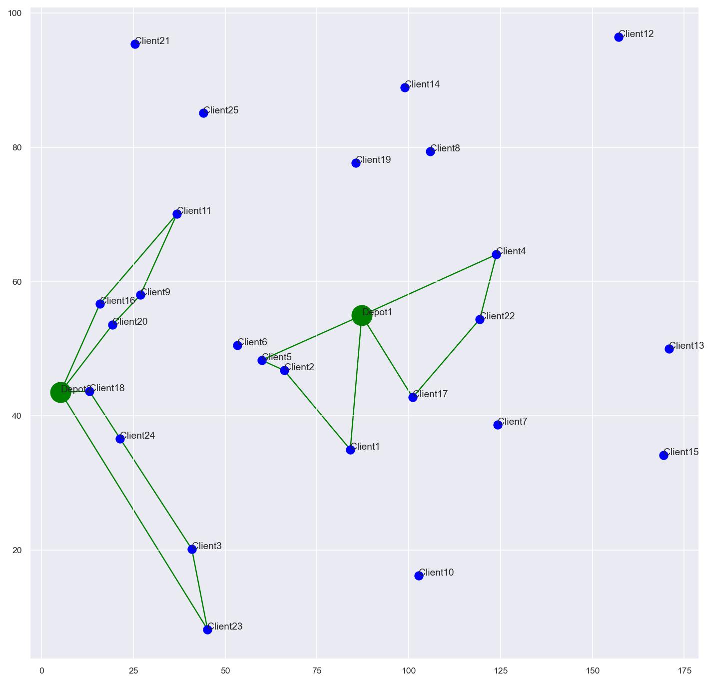
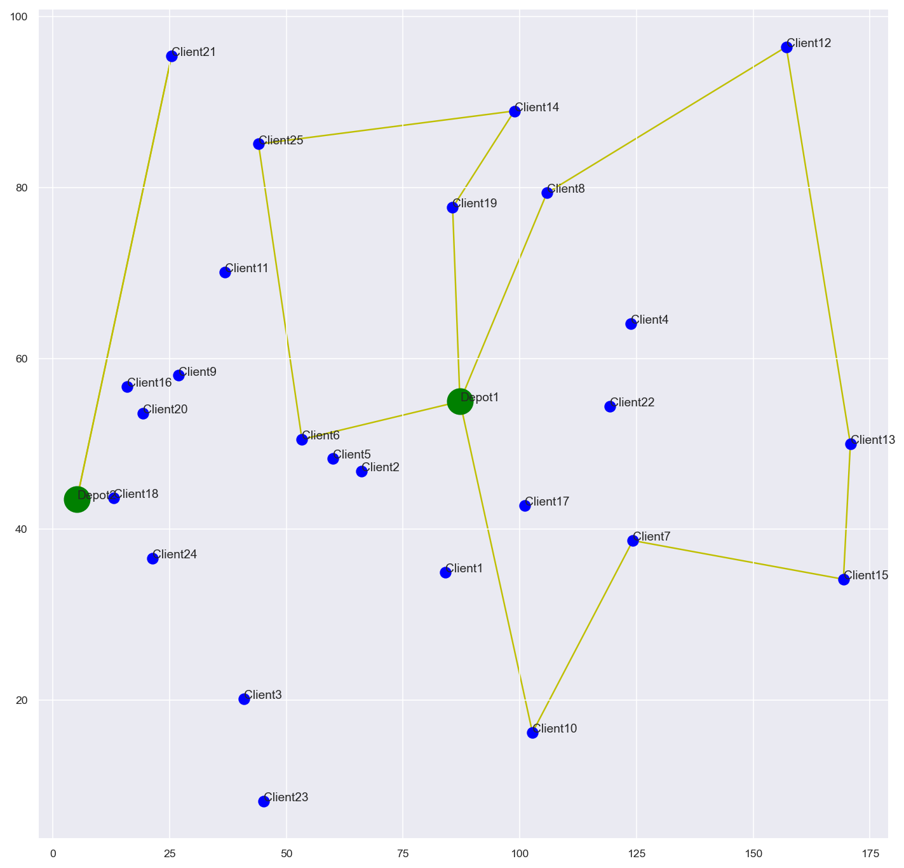
Multi-Depot Green Vehicle Routing Problem
GVs routes
TSP(CVs) routes

Slide 12
Multi-Depot Green Vehicle Routing Problem
Further Research
Implement variants of the PBA.
Grouped such that depots have the same load of work.
With AFSs along the route
What if we include hybrid vehicles?
Scenario, a distributor wants to extent/facilitate his distribution services.
here will he build the new depot(s)?

Slide 13
Multi-Depot Green Vehicle Routing Problem (MDGVRP)
https://github.com/acquayefrank/aql_project

